Slide 1

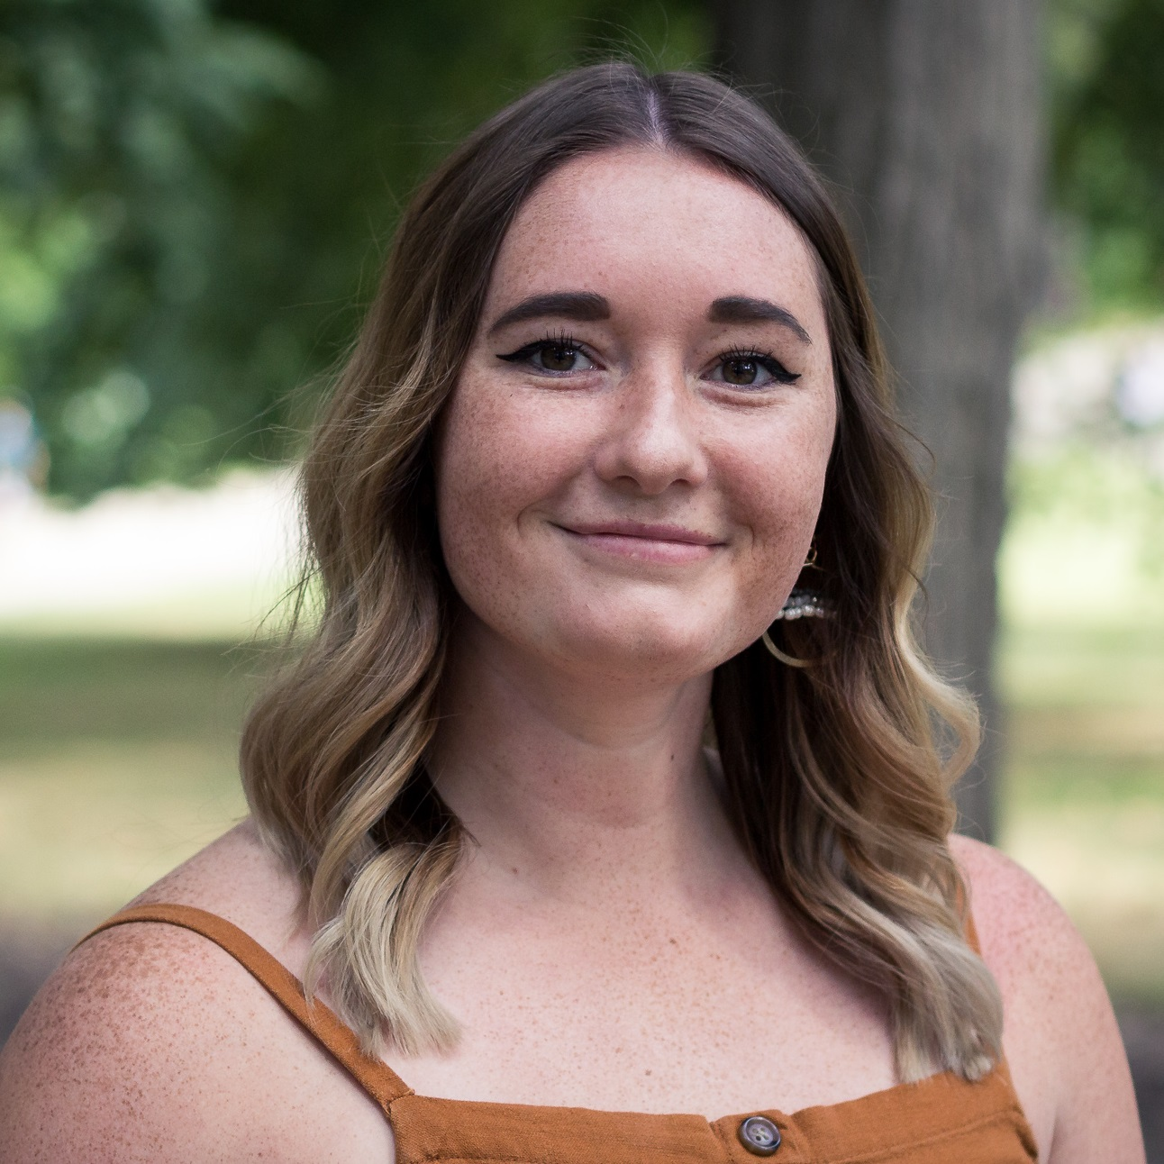
Neural mechanisms involved in L2 predictive processing:
An EEG study
EuroSLA 30 Doctoral Workshop
Brittany Finch

Slide 2
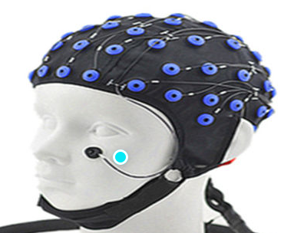
Background
Predictive processing: “pre-activation/retrieval of linguistic input before it is encountered by the language comprehender” (Huettig, 2015, p. 122 in Godfroid, 2020)
Electroencephalogram (EEG): “means of
measuring electrical potentials in the brain
by placing electrodes across the scalp”
(Harley, 2008)
Notes:
-

Slide 3
Background Cont.
Event-related potential (ERP): “electrical activity in the brain after a particular event” (Harley, 2008)
Two-systems account of prediction: system one, which includes the “simple associative mechanisms which lead to pre-activation of linguistic input” (Huettig, 2015), and system 2, complex computations (Kahneman, 2011)

Slide 4
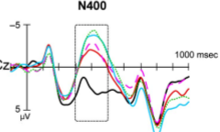
Background Cont.
N400: negative component around 400ms; linked to the stream responsible for computing semantic features and associative relationships (system 1) (Kuperberg, 2007)

Slide 5
Previous Studies
Evidence from eye-tracking
  L1 speakers make predictions based on previous input (Altmann & Kamide, 1999; Boland, 2005; DeLong, Urbach & Kutas, 2005, Kamide, Scheepers, & Altmann, 2003)
  L2 speakers of English predict similarly to L1 speakers (Bar, 2007; Dijkgraaf, Hartsuiker, & Duyck, 2017; Gollan et al., 2008; Kaan, 2014; MacDonald, 2013)

Slide 6
Previous Studies Cont.
Evidence from EEG
  Language users preactivate representations of upcoming input based on previous input (Federmeier & Kutas, 1999; Van Berkum, Brown, Zwitserlood, Kooijman, & Hagoort, 2005)
  N400s are linked to system 1 for semantic and situational prediction (Kuperberg, 2007; Kuperberg, Brothers & Wlotko, 2020)

Slide 7
Gap
Ample evidence of L1 & L2 prediction in eye-tracking
Ample evidence of L1 predictive mechanisms in EEG
BUT
To my knowledge, no studies have used ERP evidence in an L2 to determine if L2 learners are also employing these same mechanisms for prediction

Slide 8
Current study

Slide 9
Research Questions: RQ1
Does the brain engage distinct neurocognitive mechanisms in response to inputs that fulfill versus violate strong predictions at different levels of representation during language comprehension? (same as Kuperberg et al., 2020)

Slide 10
Research Questions: RQ2
Does the bilingual brain engage the same distinct neurocognitive mechanisms in response to inputs that fulfill versus violate strong predictions at different levels of representation during language comprehension as the monolingual brain?

Slide 11
Participants
Native English speakers (monolingual)
Highly proficient non-native English speakers (range of L1s)
Undergraduate or graduate students

Slide 12
Materials
Kuperberg et al. (2020)
  Scenarios in English in which prediction can be made based on semantics and contextual information
LEAP-Q language background questionnaire (Marian, Blumenfeld & Kaushanskaya, 2007) and LexTALE for L2 English proficiency (Lemhöfer & Broersma, 2012)

Slide 13
Materials Cont.
  Highly constrained contexts (The lifeguards received a report of sharks right near the beach. Their immediate concern was to prevent any incidents in the sea. Hence, they cautioned the…)
      Expected (swimmers)- highly predictable and satisfies all constraints on event and semantic level
Notes:
Counterbalanced

Slide 14
Materials Cont.
      Unexpected (trainees)- plausible but violates specific event and semantic features but not event structure/animacy
      Anomalous (drawer)- double violation for event structure/animacy and specific event/lexical item
Notes:
Counterbalanced

Slide 15
Materials Cont.
  Minimally constrained contexts (Eric and Grant received the news late in the day. They mulled over the information and decided it was better to act sooner rather than later. Hence, they cautioned the…)
    Context and semantics are not specifically constrained and will be completed with

Slide 16
Materials Cont.
      Unexpected (trainees)- plausible but unexpected (no violation of event or animacy)
      Anomalous (drawer)- violated event structure and animacy constraints but not specific event or semantics for lexical item

Slide 17
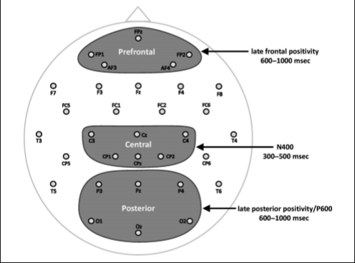
Procedure- EEG Recordings
32 sintered Ag/AgCl electrodes held to scalp with elastic cap (GND WaveGuard 64 Electrode cap)
  Amplified using a Full-band EEG DC Amplifier, 256Hz sampling rate (bandpass filter of 0.01–40Hz- applied offline)
  All signals will be recorded continuously
Notes:
Presentation of stimuli. Each trial began with the prompt “READY?” (centered in green font). When participants initiated the trial with a button press, the first two sentences werepresented successively in full on the screen. Participants advanced through these sentences at their own pace using a button press. Then a centered fixation cross appeared (750 msec; 100 msec ISI), followed by the third sentence, which was presented word-by-word (each word 450 msec; 100 msec ISI). After the sentence-final word (SFW), a “?” appeared (centered, magenta font), prompting participants to make an acceptability judgment about whether or not the preceding scenario “made sense” or not. The “?” remained on the screen until the response was registered.

Slide 18
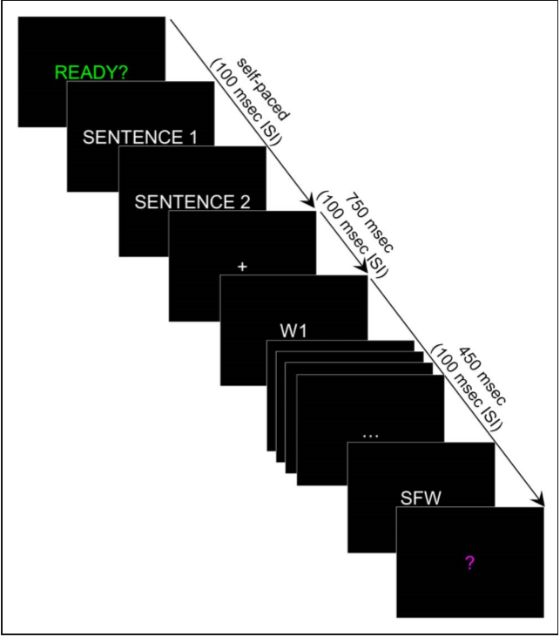
Procedure- Stimulus Presentation
PsychoPy
Advance at their own pace through 166 trials
  Example of 1 to the right
Notes:
Presentation of stimuli. Each trial began with the prompt “READY?” (centered in green font). When participants initiated the trial with a button press, the first two sentences werepresented successively in full on the screen. Participants advanced through these sentences at their own pace using a button press. Then a centered fixation cross appeared (750 msec; 100 msec ISI), followed by the third sentence, which was presented word-by-word (each word 450 msec; 100 msec ISI). After the sentence-final word (SFW), a “?” appeared (centered, magenta font), prompting participants to make an acceptability judgment about whether or not the preceding scenario “made sense” or not. The “?” remained on the screen until the response was registered.

Slide 19
Procedure- Stimulus Presentation
Cont.
Sentences 1&2 presented as a whole (set the scenario)
Sentence 3 presented word-by-word (violates or fulfills prediction)

Slide 20
Procedure- Stimulus Presentation Cont.
After each trial, judge whether scenario made sense
After 32 trials, answer a comprehension question about the preceding scenario

Slide 21
READY?

Slide 22
THE LIFEGUARDS RECEIVED A REPORT OF SHARKS RIGHT NEAR THE BEACH.

Slide 23
THEIR IMMEDIATE CONCERN WAS TO PREVENT ANY INCIDENTS IN THE SEA.

Slide 24
+

Slide 25
HENCE,

Slide 26
THEY

Slide 27
CAUTIONED

Slide 28
THE

Slide 29
SWIMMERS.

Slide 30
...

Slide 31
?

Slide 32
YES/NO QUESTION

Slide 33
Expected Results
Unexpected words for both conditions (high constraint and low constraint) = larger N400 effects than the expected words in the highly constrained condition (Kuperberg et al., 2020)
  Support for system one of the two-systems account by Kahneman (2011)
  Evidence that L2 speakers use the same mechanisms for predictive processing

Slide 34
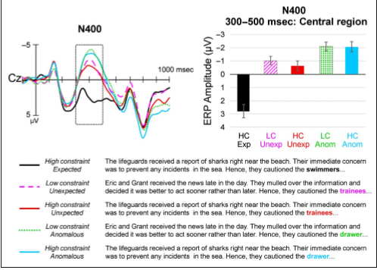
Expected Results Cont

Slide 35
Questions
Would it be plausible to use eye-tracking simultaneously to add another way of telling that participants are indeed predicting?
The original study (Kuperberg et al., 2020) also included implausible words to make two other conditions (highly constrained anomalous and minimally constrained anomalous), which were also analyzed using N400s. Should I also include these?

Slide 36
Questions Cont.
Kuperberg et al. (2020) looked at P600s as well. Should I do this as well although I am looking for support of the semantics/associations, which are shown through N400s?
Should I aim for the same L1 background or is a variety fine? Would this possibly affect brain activity?

