Slide 1
Understanding the role of literacy in semantic prediction
Brittany Finch
Michigan State University
AAAL 2022

Slide 2
Predictive processing
  Individuals make predictions about upcoming input based on what has already been read in written input or heard in spoken input (preactivation)
  Plays a key role in how linguistic input is processed (Altmann & Mirkovic, 2009)
Prediction occurs for a variety of language comprehenders
  L1 speakers (Altmann & Kamide, 1999; Mishra et al., 2012)
  L2 speakers of English (Dijkgraaf et al., 2017)
  Children (Mani & Huettig, 2014)
  Different types of prediction
Notes:
Situational constraints affect the expectations for upcoming input
Knowledge of associations and co-occurences
Grammatical knowledge influences prediction

Slide 3
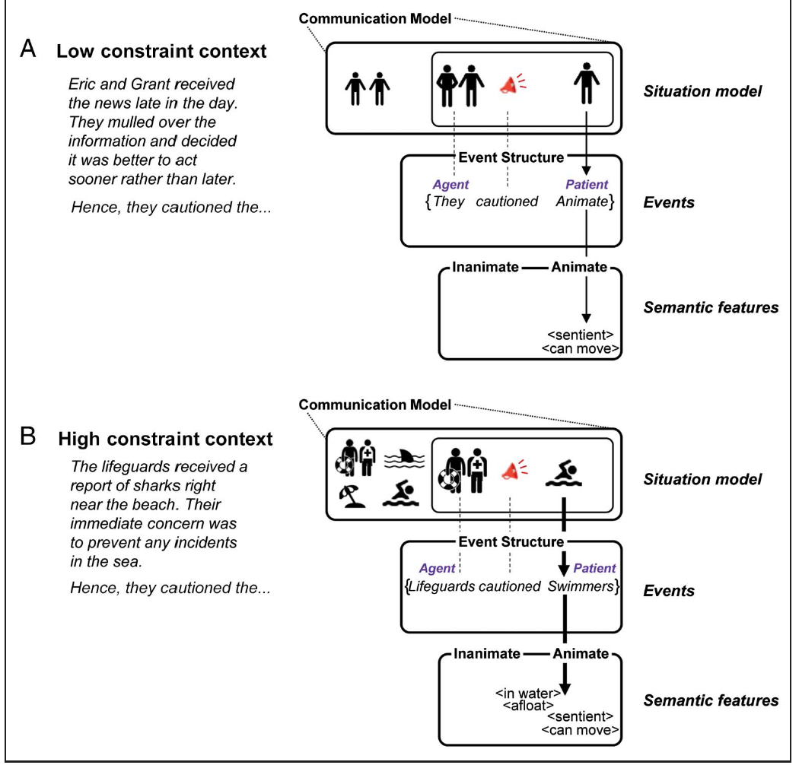
Types of prediction
  Contextual (Kuperberg et al., 2020)

Slide 4
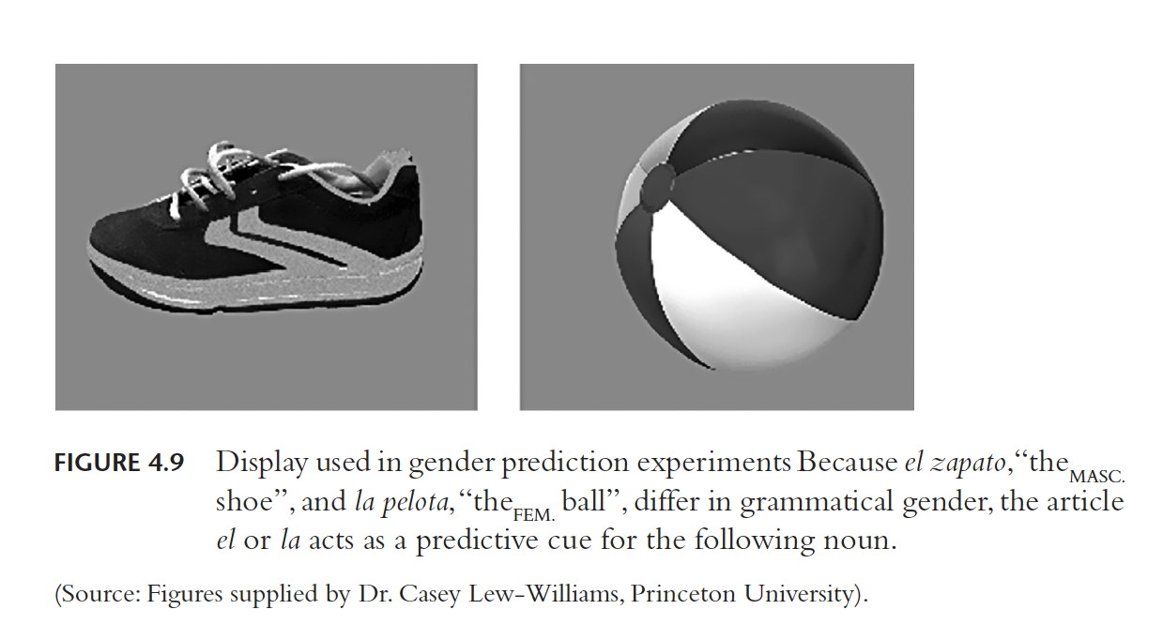
Types of prediction
Syntactic (Grüter et al., 2012; Lew-Williams & Fernald, 2007; Lew-Williams & Fernald 2010)

Slide 5
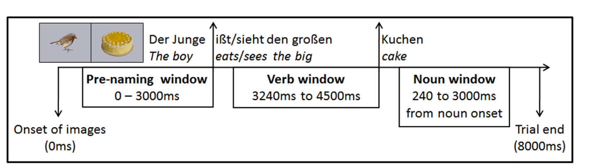
Types of prediction
  Semantic (Mani & Huettig, 2014)

Slide 6
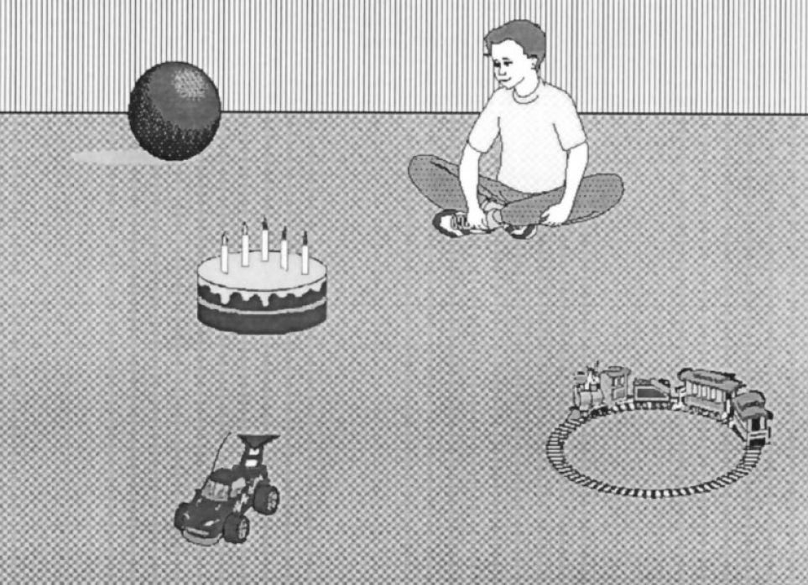
Visual World Paradigm
Participants’ eye-movements are recorded while they look at images on a screen and listen to recorded sentences (Eberhard et al., 1995)
Altmann & Kamide (1990)
  Provided initial evidence of semantic prediction in L1
  The boy will eat the cake vs the boy will move the cake

Slide 7
Individual differences in prediction
Individual differences affect prediction
  Working memory (Kim et al., 2018)
  Vocabulary size (Hintz et al., 2017; Peters et al., 2018)
  Language experience (Favier et al., 2021; Huettig et al., 2011; Kukona et al., 2016; Mishra, et al. 2012

Slide 8
Literacy as an individual difference
“understanding, evaluating, using and engaging with written text to participate in the society, to achieve one's goals and to develop one's knowledge and potential” (Program for the International Assessment for Adult Competencies, n.d.)
Can improve language skills, memory, and a wealth of other skills (Huettig & Pickering, 2019)
Changes the brain (Huettig, 2015)

Slide 9
Literacy as an individual difference
Impacts semantic and syntactic prediction above and beyond other cognitive abilities (Favier et al., 2021; Hintz et al., 2017; Kukona et al., 2016)
Affects the cues that are used in prediction (semantic, not phonological) (Huettig et al., 2011; Huettig et al., in press)
Causes underdeveloped or undeveloped mechanisms (Mishra et al., 2012)
Mediates prediction in children (Mani & Huettig, 2014)

Slide 10
Gap
Literacy and formal education previously confounded
  Except for Mani & Huettig (2014)
Different types of prediction may be affected differently
  Different processing streams (Kahneman, 2011; Kuperberg, 2007)
  Practice of reading develops structural links (Mishra et al., 2012)
    But what about semantic links? (Huettig et al., 2011)
High literacy levels of “low literate” groups (Favier et al., 2021; Kukona et al., 2016; Mani & Huettig, 2014; except for Mishra et al., 2012)
Notes:
Children, or developing readers, whose cognitive skills that were still developing

Slide 11
Research question & hypothesis
Research question
  Does literacy level affect adult monolinguals’ ability to engage in semantic predictive processing while listening?
Hypothesis
  As previous research found, emerging literate participants should not look to the target item before the onset of the noun (predict), whereas the high literate participants should
  But
  Reliance on semantic knowledge (Huettig et al., 2011) might help in semantic prediction

Slide 12
Method: Participants
Table 1. Participant information
Native English speakers (N=15) | Age | Years of formal education | Literacy level (SDQA)
High literates (n=10) | 22.6 | 15.3 | Grade 10 (122.8 words)
Emerging literates (n=5) | 29.8 | 11.2 | Grade 4 (61.8 words)
Note. Emerging literate means reading level at or below grade 5, high literate means reading at or above grade 6 (McCray, 2005)
Notes:
SD

Slide 13
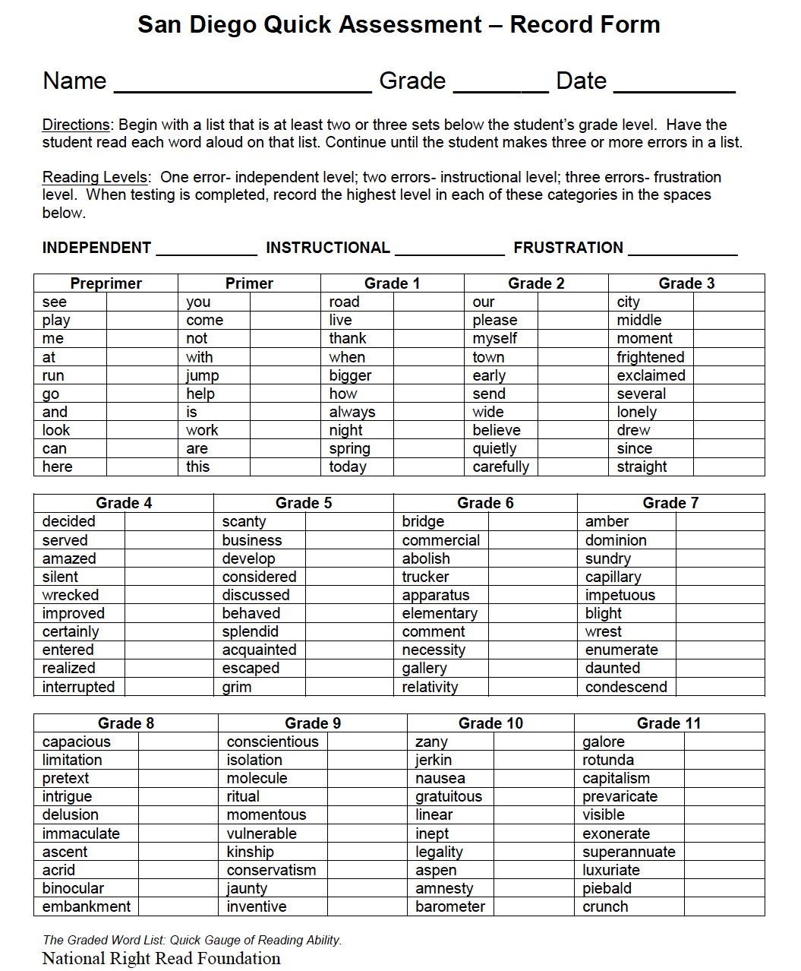
Method: Materials
San Diego Quick Assessment (SDQA)
  To assess literacy level
Look and listen task (Visual world paradigm) (Altmann and Kamide, 1999; Dijkgraaf et al., 2017; Mishra et al., 2012)
    18 experimental trials
    18 fillers

Slide 14
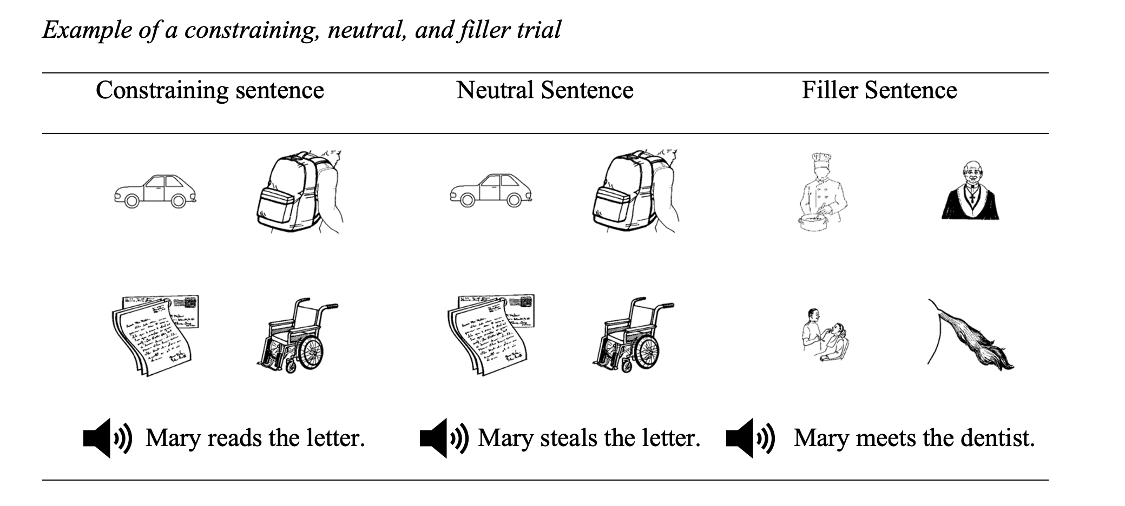
Line drawings of frequent and common objects
Sentences recorded by native speaker of English
Prediction based on verb semantics

Slide 15
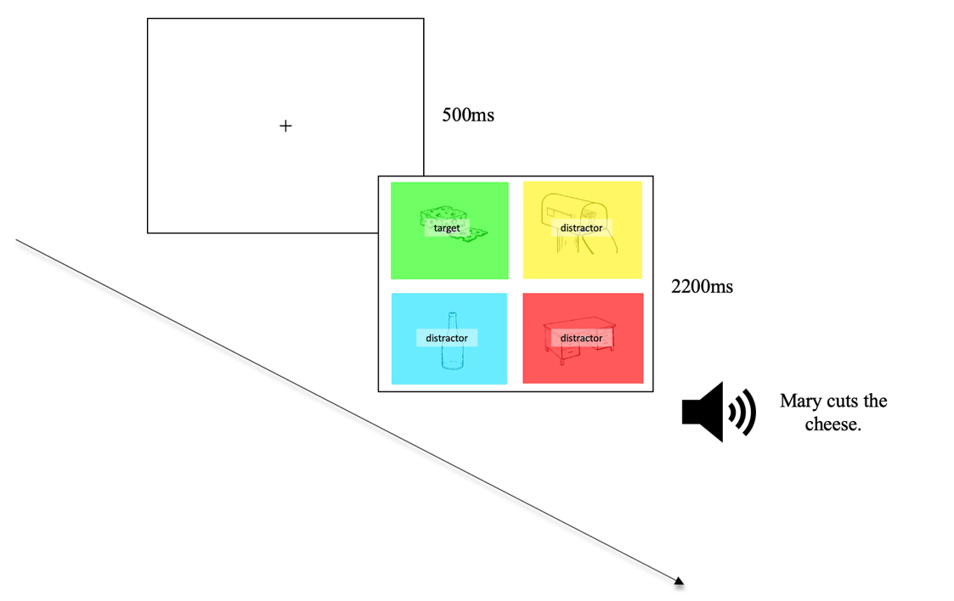
Method: procedure
Eye movements recorded with Tobii TX300 eye-tracking system with a 300Hz sampling rate (about every 3.3 seconds)

Slide 16
Analysis continued
Gaze plots
Time course graphs from verb onset to noun onset
  Verb onset + 350ms and noun onset + 200ms to allow for eyes to move (Dijkgraaf et al., 2017)

Slide 17

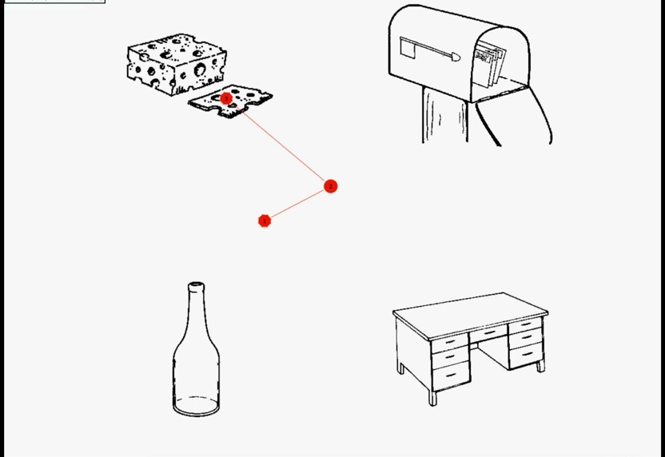
Results: Gaze plots
High literate participant during constraining sentence

Slide 18
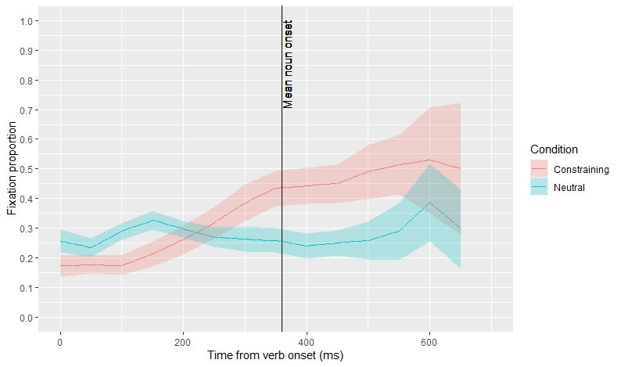
Results: Time course graphs
Figure 1. Time course graph for high literates
Analysis = Verb onset +350ms to Noun onset + 200ms
Notes:
Enlarge the graph and make sure axes and words are visible
Cut of key and put it in the grey space on the graph

Slide 19

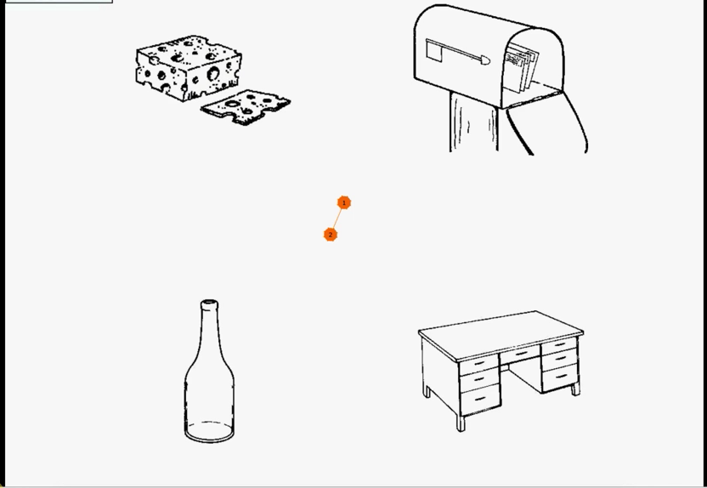
Results: Gaze plots
Emerging literate participant during constraining sentence

Slide 20
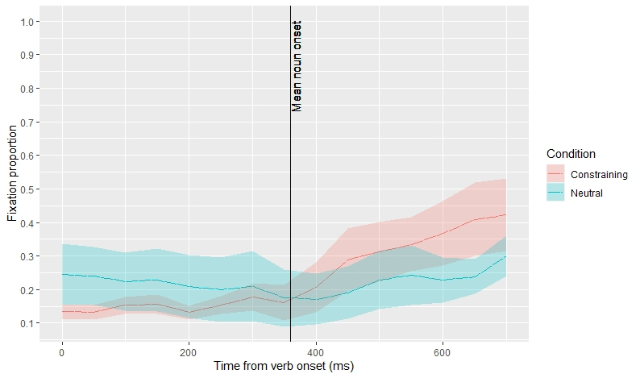
Results: Time course graphs
Figure 2. Time course graph for emerging literates
Analysis = Verb onset +350ms to Noun onset + 200ms

Slide 21
Results continued
High literates first shifted to target object around 650ms after verb onset
  Started to predict well before noun onset
Emerging literates only started to shift to the target after noun onset
  No early eye shift or divergence from neutral condition

Slide 22
Discussion
Support for formal education and literacy as separable constructs (Mishra et al., 2012)
  Formal education: literate = 15.3, emerging literate = 11.2
  Literacy level: literate = grade 10, emerging literate = grade 4
High literates showed evidence of prediction, though it was slightly delayed
Emerging literates showed slower processing overall and lack of predictive processing
  Even though low literates in Huettig et al. (2011) relied more heavily on semantic cues, emerging literates did not predict based on verb semantics

Slide 23
Discussion continued
Acquisition and practice of reading increases likelihood of prediction
  “Learning to read and write fine-tunes anticipatory mechanisms that involve the retrieval of associated words and the pre-activation of fine-grained (e.g., semantic and syntactic) representations of upcoming words” (Mishra et al., 2012)

Slide 24
Limitations
Sample size, especially for emerging literates
  Inferential stats and power
We still don’t know why exactly literacy affects prediction
  Lack of word form information?
  Co-occurrence stats developed in listening not enough? Do we also need the extra input from reading?
  Cognitive skills such as verbal working memory developed in reading
    Are these cognitive skills underdeveloped in emerging literates?
  Involvement of reading areas in the brain?

Slide 25
Implications
For this project:
  Collect more data
    Cluster-based permutation analysis
  Examine the impact of a diverse literate group (low and high education)
In general:
  More research to be done on non-WEIRD populations (high and low literate)
  The potential mechanisms of predictive processing
    What exactly is it about literacy that develops predictive processing?

Slide 26
Thank you! finchbr1@msu.edu

Slide 27
References
Altmann, G. T. M., & Kamide, Y. (1999). Incremental interpretation at verbs: Restricting the domain of subsequent reference. Cognition, 73(3), 247-264. doi: 10.1016/s0010-0277(99)00059-1.
Altmann, G. T. M., & Mirković, J. (2009). Incrementality and prediction in human sentence processing. Cognitive Science, 73(4), 247-264. doi:10.1111/j.1551-6709.2009.01022.x.
Chang, F., Dell, G. S., & Bock, K. (2006). Becoming syntactic. Psychological Review, 113(2), 234-272. doi:10.1037/0033-295X.113.2.234
Clark, A. (2013). Whatever next? Predictive brains, situated agents, and the future of cognitive science. Behavioral and Brain Sciences, 36(3), 181-204. doi:10.1017/S0140525X12000477.
Dell, G. S., & Chang, F. (2014). The P-chain: Relating sentence production and its disorders to comprehension and acquisition. Philosophical Transactions of the Royal Society B: Biological Sciences, 369(1634), 20120394. doi: 10.1098/rstb.2012.0394
Dijkgraaf, A., Hartsuiker, R., & Duyck, W. (2017). Predicting upcoming information in native-language and non-native-language auditory word recognition. Bilingualism: Language and Cognition, 20(5), 917-930. doi:10.1017/S1366728916000547
Eberhard, K. M., Spivey-Knowlton, M. J., Sedivy, J. C., & Tanenhaus, M. K. (1995). Eye movements as a window into real-time spoken language comprehension in natural contexts. Journal of Psycholinguistic Research, 24(6), 409-436. doi: 10.1007/BF02143160.
Favier, S., Meyer, A. S., & Huettig, F. (2021). Literacy can enhance syntactic prediction in spoken language processing. Journal of Experimental Psychology: General.
Hintz, F., Meyer, A. S., & Huettig, F. (2017). Predictors of verb-mediated anticipatory eye movements in the visual world. Journal of Experimental Psychology: Learning, Memory, and Cognition, 43(9), 1352. https://doi.org/10.1037/xlm0000388
Huettig, F. (2015). Four central questions about prediction in language processing. Brain Research, 1626, 118–135. doi:10.1016/j.brainres.2015.02.014.
Huettig, F., Olivers, C. N., & Hartsuiker, R. J. (2011). Looking, language, and memory: Bridging research from the visual world and visual search paradigms. Acta Psychologica, 137(2), 138-150. doi: 10.1016/j.actpsy.2010.07.013
Huettig, F., & Pickering, M. J. (2019). Literacy advantages beyond reading: Prediction of spoken language. Trends in Cognitive Sciences, 23(6), 464-475. doi: 10.1016/j.tics.2019.03.008.
Kahneman, D. (2011). Thinking, fast and slow. New York, NY: Macmillan.
Kim, A. E., Oines, L., & Miyake, A. (2018). Individual differences in verbal working memory underlie a tradeoff between semantic and structural processing difficulty during language comprehension: An ERP investigation. Journal of Experimental Psychology: Learning, Memory, and Cognition, 44(3), 406. doi: 10.1037/xlm0000457
Kukona, A., Braze, D., Johns, C. L., Mencl, W. E., Van Dyke, J. A., Magnuson, J. S., ... & Tabor, W. (2016). The real-time prediction and inhibition of linguistic outcomes: Effects of language and literacy skill. Acta Psychologica, 171, 72-84.
Kuperberg, G. R., Brothers, T., & Wlotko, E. W. (2020). A Tale of two positivities and the N400: Distinct neural signatures are evoked by confirmed and violated predictions at different levels of representation. Journal of Cognitive Neuroscience, 32(1), 12-35. doi: 10.1162/jocn_a_01465
Mani, N., & Huettig, F. (2014). Word reading skill predicts anticipation of upcoming spoken language input: A study of children developing proficiency in reading. Journal of Experimental Child Psychology, 126, 264-279. doi:10.1016/j.jecp.2014.05.004.
Mishra, R.K., Singh, N., Pandey, A., Huettig, F. (2012) Spoken language-mediated anticipatory eye movements are modulated by reading ability: Evidence from Indian low and literates. Journal of Eye Movement Research, 5(1), 1–10. doi:10.16910/jemr.5.1.3.
Peters, R. E., Grüter, T., & Borovsky, A. (2018). Vocabulary size and native speaker self-identification influence flexibility in linguistic prediction among adult bilinguals. Applied Psycholinguistics, 39(6), 1439-1469. doi: 10.1017/S0142716418000383
Program for the International Assessment for Adult Competencies (PIAAC) - Literacy Domain. (n.d.). Retrieved from https://nces.ed.gov/surveys/piaac/literacy.asp

